Slide 1
NCryptfs:
A Secure and Convenient Cryptographic File System
Charles P. Wright, Michael C. Martino, and Erez Zadok
USENIX 2003
Presentation by Yoav Klein

Slide 2
Introduction
Why do we need Cryptographic File Systems?
  Physical Security failures
  Convenience and Ease of Use

Slide 3
Introduction
Cryptographic File Systems in use today
  EFS (Windows 2000 and later)
    NTFS file/folder attribute: Encrypt
  FileVault (Mac OS X) / BitLocker (Vista)
    Home Directory / OS Volume encryption
  TrueCrypt (Linux/Windows) / BestCrypt (Linux)
    Whole disk (partition) encryption

Slide 4
Introduction
Desired Properties
Transparency
  Rational key management
  Transparent access semantics
  Transparent performance
  Natural key granularity

Slide 5
Introduction
Desired Properties
Secrecy
  Protection of file contents
  Protection of sensitive meta-data
  Protection of network connections
  Limited trust

Slide 6
Introduction
Desired Properties
Compatibility
  Compatibility with underlying system services
  Portability
  Scale
  Concurrent access
  Compatibility with future technology

Slide 7
Unix Review
Unified File System
/
bin
boot
dev
etc
lib
home
root
usr
bin
include
lib
share
var
log
mail
www
/
bin
boot
dev
etc
lib
home
root
usr
var
bin
include
lib
share
log
mail
www
Virtual Representation
On-Disk Representation: 3 Partitions

Slide 8
Unix Review
File Properties
lrwxrwxrwx yklein yklein 21 2007-05-05 15:08 Shared
-rw-r--r-- yklein yklein 118K 2006-12-22 01:20 table1.ps
-rwxr-xr-x root root 15K 2006-09-18 11:50 echo
-rw-r--r-- root root 1001 2007-04-21 17:06 group
-rw------- root root 983 2007-04-21 15:12 group-
-rw-r----- root shadow 868 2007-04-21 17:06 gshadow
-rw------- root root 853 2007-04-21 15:12 gshadow-
-rw------- fetchmail root 388 2007-04-16 21:50 fetchmailrc
-r--r----- root root 302 2006-09-20 12:23 sudoers
drwx------ root root 4.0K 2007-04-22 00:20 .w3m/
drwx------ root root 4.0K 2006-11-27 23:37 .ssh/
-rw------- root root 887 2006-11-27 23:36 id_rsa

Slide 9
Architecture
Tradeoffs
Security | Performance
Convenience | Portability

Slide 10
Architecture
Players
System Administrator
  Not trusted with encryption keys
Owners
  Provides encryption keys to NCryptfs
Readers and Writers
  Receive permissions from Owner

Slide 11
Architecture
Stackable File Systems
CFS/TCFS use NFS, TrueCrypt/BestCrypt use loopback device drivers
NCryptfs is a stackable file system – a higher level of abstraction than “native” filesystems (EXT2, NFS, etc.)
NCryptfs uses native filesystems to store the data on the device (or across the network)

Slide 12
Architecture
Attachments
NCryptfs Filesystem
NFS Filesystem /proj/src
EXT2 Filesystem /home/cwright/mail /home/mcm/enc
/mnt/ncryptfs
proj Authorized:
Mike, Erez
cpw Charles
mcm Mike
Cleartext View
Ciphertext View

Slide 13
Architecture
Attachments
Attach
Does not hide files
Does not add new files
Does not change permissions
Attaching is a safe operation for regular users
Mount
Can hide files
Can add dangerous files
Can add files with any permissions (setuid)
Mounting is a dangerous operation; requires superuser attention

Slide 14
Architecture
Attachments
How are attachment names selected?
Chosen by the owner
  Convenient, but can reveal information
Using system ID’s (e.g. u500s500)
  Less convenient, and may not be unique
Unique, randomly generated character string
  Least convenient, but unique and secure

Slide 15
Architecture
Attachment Properties
Encryption Key
  Provided by Owner on attach; kept in core memory
Authorizations
  Provide access to the attachment for certain entities
Active Sessions
  List of authenticated users, sessions, and processes

Slide 16
Architecture
Attachment permissions
Each Authorization and Active Session also specifies various permissions
Read / Write / Execute
Detach
Add / List / Delete Authorizations
List / Revoke Active Sessions
Bypass VFS Permissions

Slide 17
Architecture
Groups – Users Sharing Data
Standard Unix Groups
  File permissions are unchanged
Ad-hoc Groups
  NCryptfs can bypass system permissions
Delegation of Permission
  Users can delegate their permissions to other users

Slide 18
Architecture
Timeouts
All file operations fail
Opening new files fails. Currently open files continue to function
Opening new files requires re-authentication. Currently open files continue to function
All file operation require re-authentication
Re-authentication puts the process to sleep until the password is supplied

Slide 19
Architecture
Implementation Details
Linux system modified in several ways
  Processes given on-exit callbacks
  ioctl modified to add challenge-response
  VFS permissions bypassed by changing process owner
Caches cleared as soon as possible
  Page cache, dcache, icache

Slide 20
Architecture
Implementation Details
Files are encrypted one page at a time
  Best security: Whole file encryption
  Best performance: one byte at a time
File names are also encrypted
  Base64 encoding to ensure ASCII name
  Checksum prefixed to file name

Slide 21
Performance
Testing
Two tests – one CPU intensive, one I/O intensive
Four systems: CFS, TCFS, BestCrypt, and NCryptfs
Comparison: Baseline (Ext2), No encryption (NULL), and Blowfish
Elapsed time and System time

Slide 22
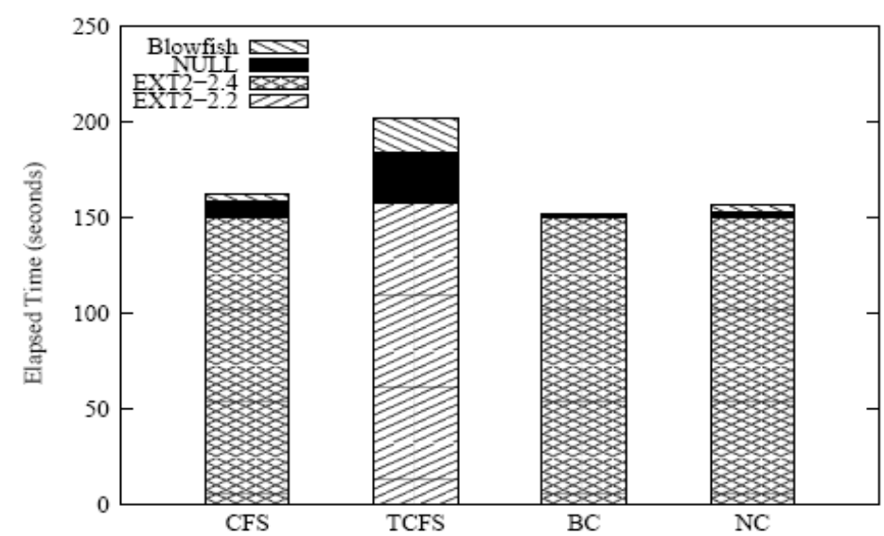
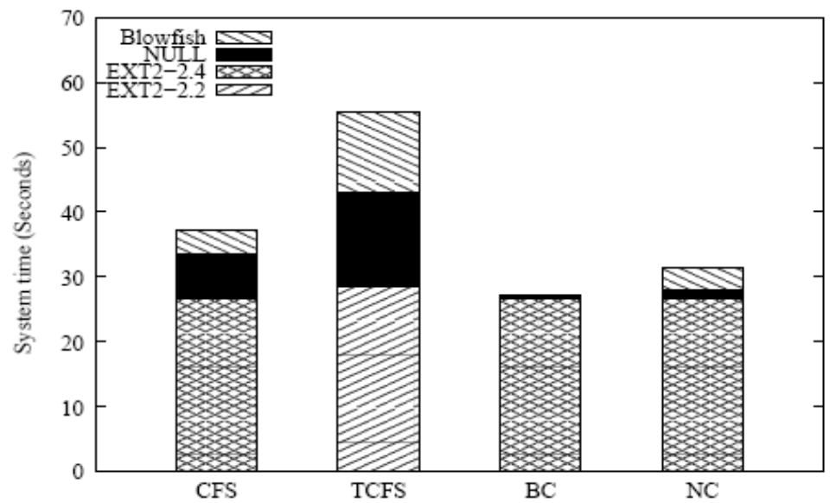
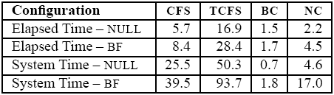
Performance
CPU-Intensive Test

Slide 23
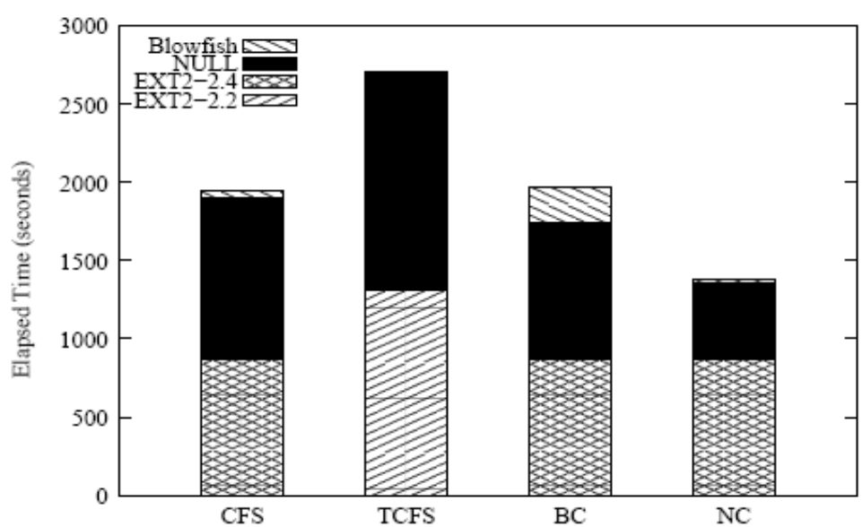
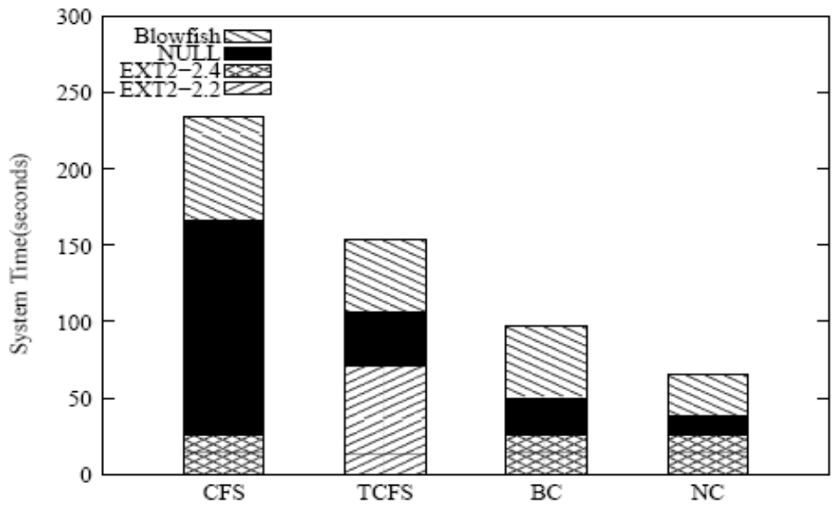
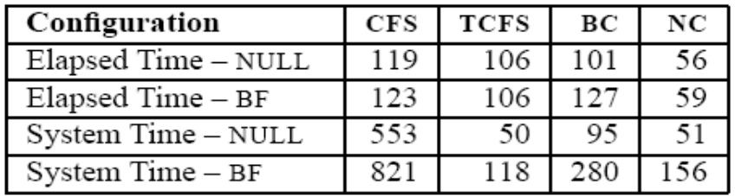
Performance
I/O-Intensive Test

Slide 24
Conclusion
Secure
  Separate encryption/authentication, fixed system issues, timeouts, session/process based
Convenient
  Transparency, ad-hoc groups, user space attach
Performance
  All operations in kernel space
Portable
  Based on a portable stackable file system

Slide 25
NCryptfs:
A Secure and Convenient Cryptographic File System
The End
Thank you for your attention

Slide 26
Questions
Send answers to yoavkle1@post.tau.ac.il
Why are CFS/TCFS much slower than NCryptfs?
What is the main difference between an owner and a reader/writer?
Why does NCryptfs separate encryption from authentication?
Why is attach a safe command for users, while mount is considered to be unsafe and requires superuser privileges?

